Slide 1
Cancer Detection using machine learning
Nishchay Trivedi (1106924)
Shiv Hansoti (1105615)

Slide 2
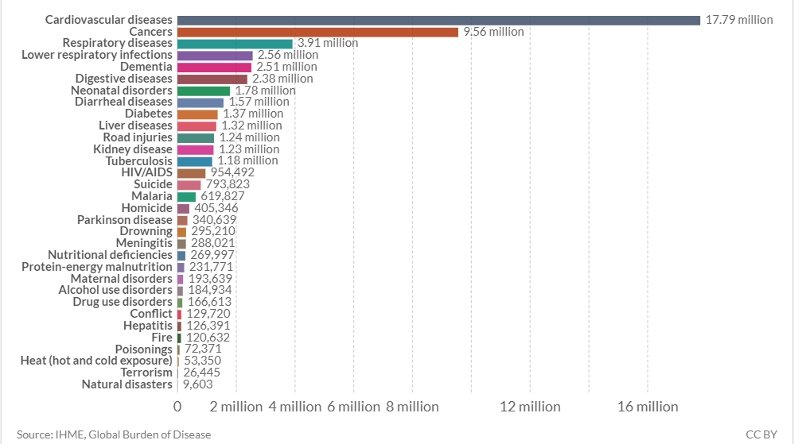
Data
The Problem
Solution Proposal
Wireframes
Next Steps

Slide 3
9.56 Million People in the world die due to cancer. It is the second most deathly factor. Many people lose their loved ones due to it. So this is just a try to solve the problem of medical science using advanced computer science research techniques and algorithms.

Slide 4
Literature
Review:
Image processing techniques for analyzing CT scan images towards the early detection of lung cancer
Dataset-type:- X-Ray, MRI, CTScans.
Cancer at first stage can increase survival chance from 15 to 50 years.
Pre-processing using intensity measure(Locate particels), standard segmentation(marking cancer nodules), feature extraction (area, perimeter, eccentricity,centroid, diameter, pixel mean intensity).
Designed multi-layer Neural network architecture with infusion of Image Processing Techniques (image erosion, median filtering, thresholds, and color attribute feature extraction method).
Binarization approach to detect lung cancer.
This helped in distinguishing benign and malignant tumors from the CTScanned images.
Author:-Jeyaprakash Vasanth Wason

Slide 5
Literature
Review:
Breast Cancer Classification
Dataset:- WBCD (Wisconsin Breast Cancer).
Aim: to classify Breast Cancer using WBCD
A multilayer perceptron (MLP) neural network based on enhanced non-dominated sorting genetic algorithm (NSGA-II) to optimize accuracy and network structure
Compared to other methods, this work improves classiﬁcation accuracy
However, MLP can get stuck in local minima.
Author: Jeyaprakash Vasanth Wason
hybrid feature selection approach
Designed genetic algorithm wrapper (IGSAGAW), to remove the redundant and irrelevant feature from the feature space and cost-sensitive support vector machine (CSSVM) learning algorithm.
High Accuracy for classification and reduced computational cost.
Author: Anjali Sevani

Slide 6
Literature
Review:
Breast Cancer Classification
Dataset:- Hospital Private Dataset of Breast Tissues. (Data were acquired using electrical impedance spectroscopy (EIS) method).
Aim: Automated system for the classiﬁcation of breast tissue
Feedforward neural network using the backpropagation learning algorithm (BPNN) and radial basis function network (RBFN).
Breast cancer tissues were classiﬁed into six diﬀerent tissues, Carcinoma, Fibro-adenoma, Mastopathy, Glandular, Connective, and Adipose tissue
The Radial basis function network outperforms the back-propagation network for classifying six diﬀerent breast tissues in terms of accuracy, minimum error, maximum epochs, and training time. The proposed system improved accuracy and decreases training time.
neural networks can be weak in generalizing and can get stuck in local optima.
Author: Abdulkader, H., John, B. I., Rahib

Slide 7
Literature
Review:
Breast Cancer Classification
Dataset:- the Wisconsin Breast Cancer (WBC) dataset and the Wisconsin Diagnostic Breast Cancer (WDBC) dataset with SEER Dataset.
Aim: designed an SVM-based ensemble learning model for breast cancer diagnosis and increases diagnosis accuracy.
The proposed ensemble model includes two types of SVM structures, i.e., a C-SVM and a R-SVM, and six types of kernel functions.
A weighted Area Under the Receiver Operating Characteristic Curve Ensemble (WAUCE) mechanism is proposed for model hybridization to import the expertise of diﬀerent base classiﬁers on diagnostic tasks.
The proposed model increases diagnosis accuracy compared to other works based on single SVM. However, it is a computationally expensive method, and the training time is high.
Author: Djihane Houfani, Sihem Slatnia, Okba Kazar, Noureddine Zerhouni,Abdelhak Merizig, and Hamza Saouli

Slide 8
Literature
Review:
Breast Cancer Classification
Dataset:- Breast Cancer Coimbra dataset (BCC) from UCI machine learning database
Aim: designed a model to increases diagnosis accuracy.
A hybrid approach based on mad normalization, KMC based feature weighting, and AdaBoost tM1 classiﬁer
the dataset was ﬁrst normalized by the MAD normalization method
k-means clustering (KMC) based feature weighting has been used for weighting the normalized data
the AdaBoost M1 classiﬁer has been used to classify the weighted data set.
This method shows good results in terms of accuracy. However, it is a computationally expensive method.
Author: Kemal, P. mit

Slide 9
Literature
Review:
Breast Cancer Classification
Dataset:- BreaKHis, a public dataset
Aim: deep learning approach to classify breast cancer histopathological images
A method based on the extraction of image patches for training the Convolutional Neural Network (CNN) and the combination of these patches for ﬁnal classiﬁcation
This method allows for avoiding adaptations of the model, leading to more complex and computationally costly architecture
However, the lack of data provides costly expensive experiments
Author: Fabio, Luiz, Caroline, Laurent.

Slide 10
ML Techniques and Approaches:
Support Vector Machine
Decision Trees
Naive Bayes
K Nearest Neighbors
Convolution Neural Network
Graph SSL
Bi-clustering with Adaboost
Recurrent Neural Network
Bi-directional Recurrent Neural Network

Slide 11
Experimental Analysis
100
SVM
NBC
DT
ANN
80
RNN
60
78%
81%
89%
92%
95%
40
20

Slide 12
Evaluation
And
Discussion
After a brief description of cancer disease and a small comparison between surveyed studies, we deduced that a large amount of cancer diagnosis studies using the machine and deep learning technics in the last decade provide accurate results.
Moreover, most of them combined multiple technics to optimize their system's performance and time response.
Artiﬁcial Neural Networks (ANN) and Support Vector Machine (SVM) are most used technics in cancer diagnosis because it provides an accurate predictive performance.
However, selecting the appropriate method depends on many parameters, including the types and the size of data, the time limitations, and the type of prediction results.

Slide 13
Evaluation
And
Discussion
Three major limitations
Small dataset: To achieve preferment classiﬁcation schemes, the size of the training datasets needs to be suﬃciently large. However, the studies surveyed in this review used small amounts of data.
Data quality: choosing the most signiﬁcant data subset utilizing feature selection methods allows providing a robust system.
Computational cost: most reviewed works are computationally expensive, which is not beneﬁcial for both clinician and patient.
Three major strengths
The improved accuracy of cancer nodule detection
classifies the detected lung cancer as malignant or benign
Removes the noises that create false detection of cancer

Slide 14
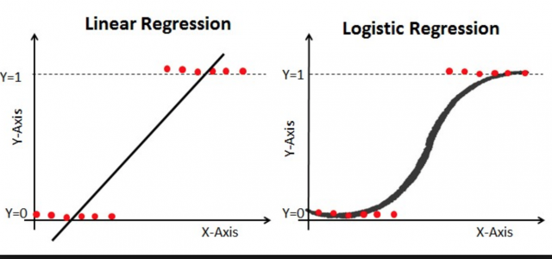
Experiment
01
1wkjdlakj as
Breast Cancer Detection (Logistic Regression)
Dataset:- The breast cancer dataset imported from scikit-learn which contains 569 samples including 30 real, positive features (including cancer mass attributes like mean radius, mean texture, mean perimeter, etcetera). Of the samples, 212 are labeled malignant and 357 are labeled benign.
Aim: logistic regression approach for classification
logistic regression also known as logit regression is done to estimate the logistic model parameters, which is a form of binary regression. Moreover, a binary logistic model always has a dependent variable with two possible values, such as pass/fail, which are represented by an indicator variable. The two values here are labeled 0 and 1.
Cancer Detection using breast cancer dataset from scikit-learn

Slide 15
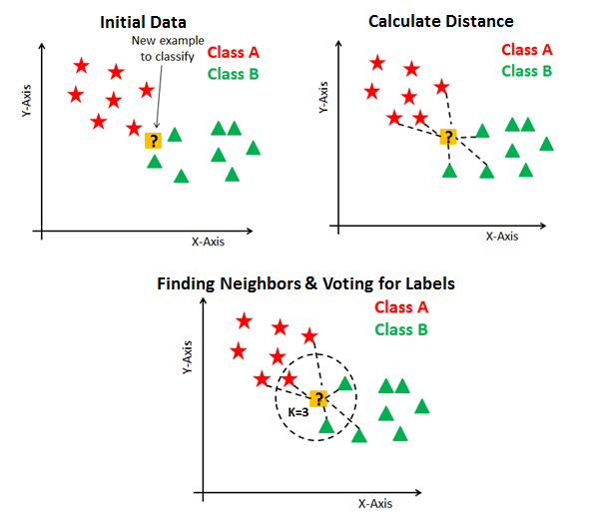
Experiment
01
1wkjdlakj as
Breast Cancer Detection (K-Nearest Neighbour)
Dataset:- The breast cancer dataset imported from scikit-learn which contains 569 samples including 30 real, positive features (including cancer mass attributes like mean radius, mean texture, mean perimeter, etcetera). Of the samples, 212 are labeled malignant and 357 are labeled benign.
Aim: K-NN approach for classification
In the k-NN classification, the result obtained is a binary categorized class. An item here is classified by a majority vote of its neighbors, assigning the object to the most common class of its nearest k neighbors where k is a positive integer. If k = 1, the object is strictly allocated to the closest single neighbor's class.
Cancer Detection using breast cancer dataset from scikit-learn

Slide 16
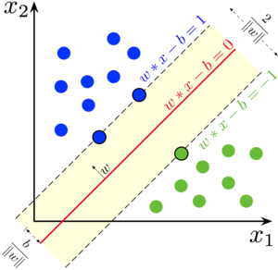
Experiment
01
1wkjdlakj as
Breast Cancer Detection (Support Vector Machine)
Dataset:- The breast cancer dataset imported from scikit-learn which contains 569 samples including 30 real, positive features (including cancer mass attributes like mean radius, mean texture, mean perimeter, etcetera). Of the samples, 212 are labeled malignant and 357 are labeled benign.
Aim: SVM approach for classification
The SVM model represents the samples as space points, represented in such a way that the different group examples are separated by a simple distance that is as wide as possible
Instead, new instances are drawn into the same space and expected to belong to a division depending on the side of the distance they fall through. In addition to performing linear classification, SVMs can effectively perform a nonlinear classification using what is called the kernel trick, projecting their inputs into high-dimensional feature spaces implicitly.

Slide 17
100
KNN
SVM
80
LR
60
79%
81%
91%
88%
40
20

Slide 18
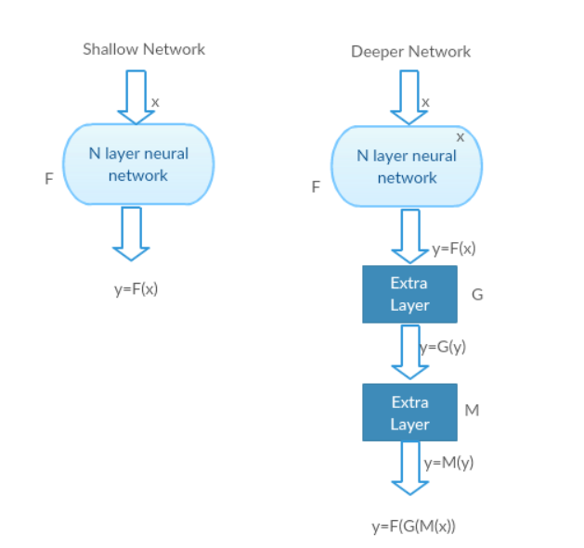
Experiment
02
1wkjdlakj as
Breast Cancer Detection (ResNet V50)
Dataset:- The original dataset consisted of 162 whole mount slide images of Breast Cancer (BCa) specimens scanned at 40x. From that, 277,524 patches of size 50 x 50 were extracted (198,738 IDC negative and 78,786 IDC positive). Each patch’s file name is of the format: uxXyYclassC.png( example 10253idx5x1351y1101class0.png) , Where u is the patient ID (10253idx5), X is the x-coordinate of where this patch was cropped from, Y is the y-coordinate of where this patch was cropped from, and C indicates the class where 0 is non-IDC and 1 is IDC.
ResNet models are implemented with a double- or triple- layer skips that do contain nonlinearities (ReLU) and use batch normalization in between. An additional weight matrix may also be used in order to learn to skip weights. These models are known as HighwayNets.
Cancer Detection using breast cancer dataset from scikit-learn

Slide 19
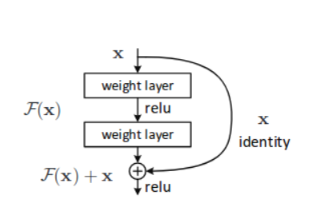
Experiment
02
1wkjdlakj as
Breast Cancer Detection (ResNet V50)
Instead of learning the direct mapping of x ->y with a the function H(x) (A few stacked non-linear layers) let us define the residual function using F(x) = H(x) — x, which can be reframed into H(x) = F(x)+x, where F(x) and x represents the stacked non-linear layers and the identity function(input=output) respectively.
If the identity mapping is optimal, We can quickly push the residuals to zero (F(x) = 0) than to fit an identity mapping (x, input=output) by a stack of non-linear layers. In simple language, it is straightforward to come up with a solution like F(x) =0 rather than F(x)=x using a stack of non-linear CNN layers as a function (Think about it). So, this function F(x) is what the authors called Residual function.

Slide 20
Experiment
02
84%
Experimental Accuracy of ResNet V50.
Result

Slide 21
identifying the recent research done in the computer science community for detecting cancer using computer-aided diagnosis.
collected the resources as much as possible, and he figured out which algorithm of machine learning was optimal for detecting cancer.
Implementation of the 3 algorithms on cancer detection dataset (LR, KNN, SVM)
Nishchay’s Contribution
Shiv’s Contribution
reading all the resources online and try to understand which machine learning technique was more suited for the corresponding dataset and why they gave that particular accuracy.
He found that Bayesian Network, Support vector machine, Artificial Neural Network, Decision tree, Convolution neural network, and Bi-directional Convolution Neural Network were majorly used to solve the problem.
Implementation of ResNet V50

Slide 22
Acknowledgement
As a project partner and student, we are thankful to Dr. Zubair Fadlullah, their teaching assistants Sadman Sakib and Tahrat Tazrin, for motivating us throughout the coursework and curriculum.
This was new for both of us, and it was like exploring the new dimension of Healthcare and the computer science world.
Moreover, most importantly, we would like to apologize if we have used any wrong terminologies as we have out knowledge limitations.
Lastly, we are both grateful for your assistance and guidance, which would elevate our character for being part of the computer science society.

